Slide 1
Priorities for the incoming government for strengthening Integrated Care Systems
A survey of 56 stakeholders by the Health Devolution Commission
Phil Hope and Steve Barwick, 10th July 2024

Slide 2
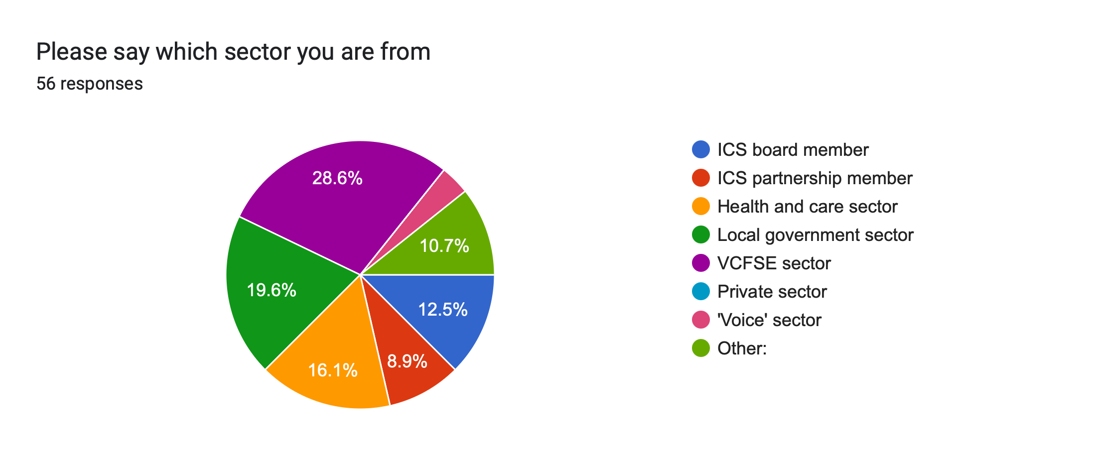

Slide 3
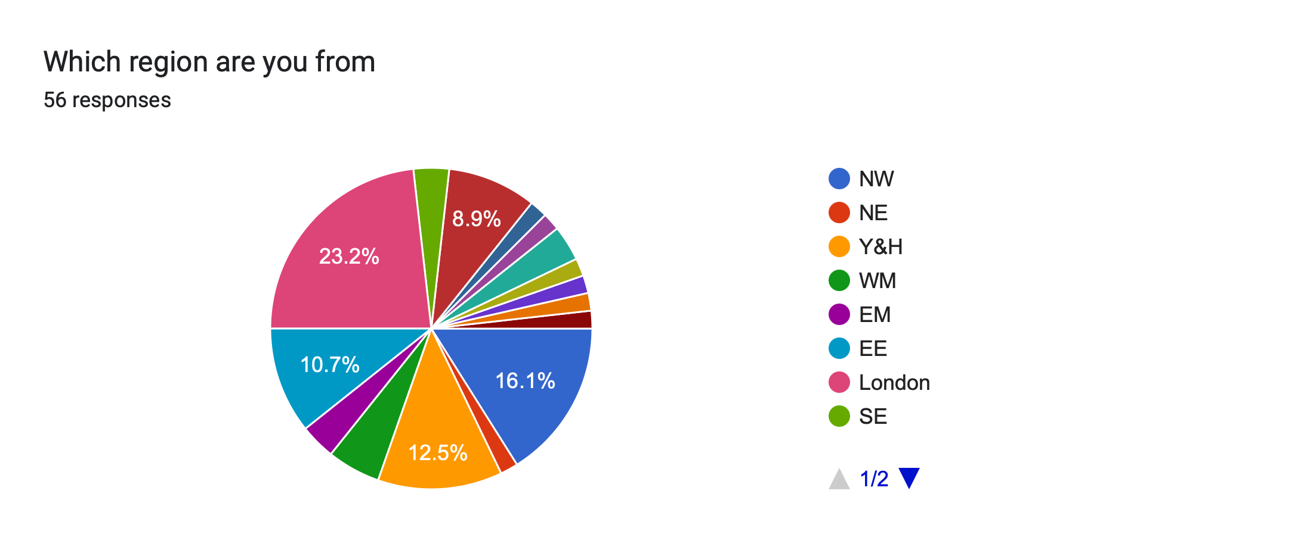
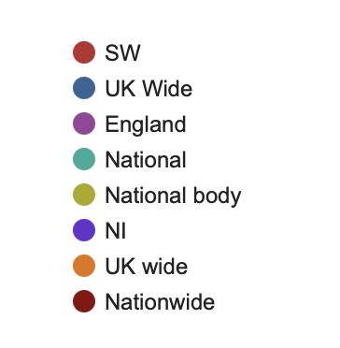

Slide 8
 | 1st Priority | 2nd Priority | 3rd Priority | 4th Priority | 5th Priority
Aims | Reducing health inequalities | Improving population health | Improving the performance of NHS and social care services | Ensuring a 'health in all policies' approach (e.g., housing) | Ensuring an 'economic benefit in health and social care policy' approach
Governance | Strong voice for those who draw on health services and social care support | Meaningful partnerships with VCFSE sector | Genuine power-sharing between NHS and Local Government | Increasing impact/status of Integrated Care Partnership in ICS | Parity of esteem between primary and secondary care
Priority groups | Children and young people | People with mental health needs, learning disabilities/autism | Minority ethnic groups and others experiencing health inequalities | Older people with frailty | Unpaid carers and volunteers
Delivery models | Shifting resources towards community, primary care, prevention and early intervention | Ensuring mature place-based partnerships and neighbourhood networks | Improving the NHS and social care workforce | Local freedom and flexibility including pooled/aligned budgets | ICS provider collaboratives reinforce place-based ways of working

Slide 9
Theme | Suggested specific actions by government to strengthen Integrated Care Systems
Resources | Create financial incentives for ICSs to: focus on reducing health inequalities and improving population health shift resources towards community-based services
Voice | Mandate ICSs to involve directly people with lived experience in service specification and delivery
VCFSE | Expect ICSs to recognise and reward the value of working in partnership with the VCFSE sector
Priority groups | Identify key priority groups and best practice for support by ICSs – children and young people, people with learning disabilities, unpaid carers, and older people with frailty
Governance | Do not re-organise. Build and strengthen the structures and accountability of the IC boards and partnerships, the place-based partnerships and primary/community care networks

