Slide 1
10 Year Health Plan
Health Devolution Commission Meeting
12/12/2024
Notes:
Standard title slide

Slide 2



The 10 Year Health Plan is part of the government’s health mission to build a health service fit for the future
A commitment to a 10-year health plan is central to the government’s Health Mission to fix the broken NHS and make it fit for the future.
The plan will deliver on the 3 big shifts needed to move healthcare from hospital to the community, analogue to digital, sickness to prevention.
The 10-year health plan will be focused on modernising the NHS, with an emphasis on meeting the healthcare needs of future generations. ​
The plan will be co-developed with the public, patients and staff so that all these groups feel ownership of the plan.
Notes:
The 10 Year Plan is the Government’s plan to fix the NHS and make it fit for the future
The plan will focus on the three big shifts needed to transform healthcare – none of these are new concepts, but progress has been slow: Hospital to community; Analogue to digital, Sickness to prevention.
The NHS needs some immediate steps to improve care rapidly, but the plan will focus on the longer term need for reform to deliver better care to future generations.
This is the start of a national conversation about the future of the NHS. To make sure we are as ambitious as we need to be, to get the NHS back on track and fit for the future, we want to make this the biggest engagement exercise with stakeholders, staff, patients and the public, in the NHS’ history.

Slide 3

Our engagement exercise launched on 21 October, including Change.NHS.uk, for the public and health and care staff to have their say
Public deliberation
Staff deliberation
System & local leadership events
Partners council
Community engagement
Online portal
Notes:
The online portal launched 21 October, with multiple ways for public and staff to get involved:
Start here survey – asking about the best things about the NHS, challenges, and how to deliver the three shifts – moving more care from hospitals to communities, making better use of technology in health and care, and moving from sickness to prevention.
Your experiences – with different surveys for people to share their experience of health and care, depending on if they are responding as a member of the public, or as a health and care professional.
Your ideas for change – for the public to suggest their idea for health and care. This is the only part of the portal where responses are public for others to up or downvote.
There is also a dedicated section of the portal for organisations to share their expertise.

Slide 4


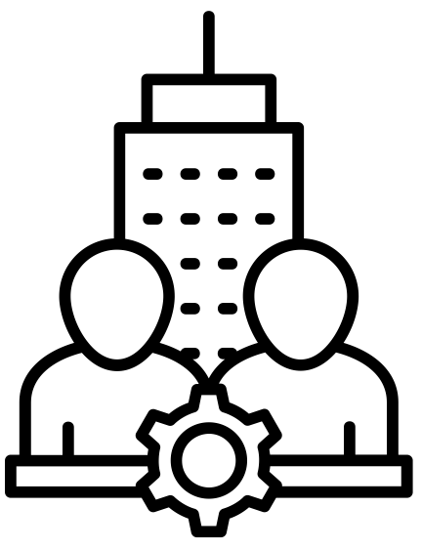

Change NHS is driving the largest ever national conversation on the future of the NHS
Over
70k
Survey responses
Over
9,000
Ideas submitted
Over
1.2 million visits
Over
6,500
Staff & patient experiences
Over
2,000
Organisations registered
Notes:
Correct as of 10/12/24
We are seeing huge levels of engagement through the national portal.

Slide 5
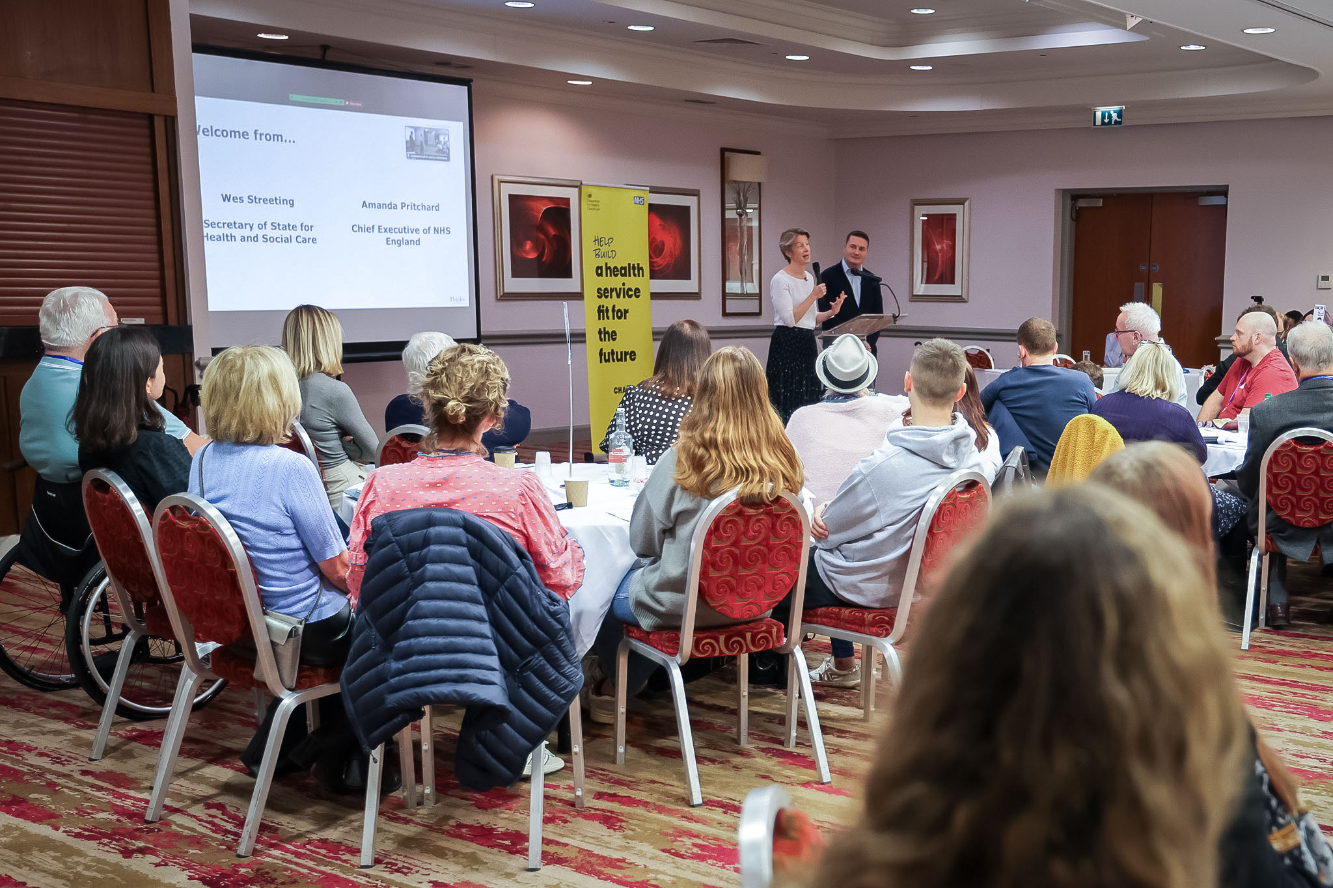
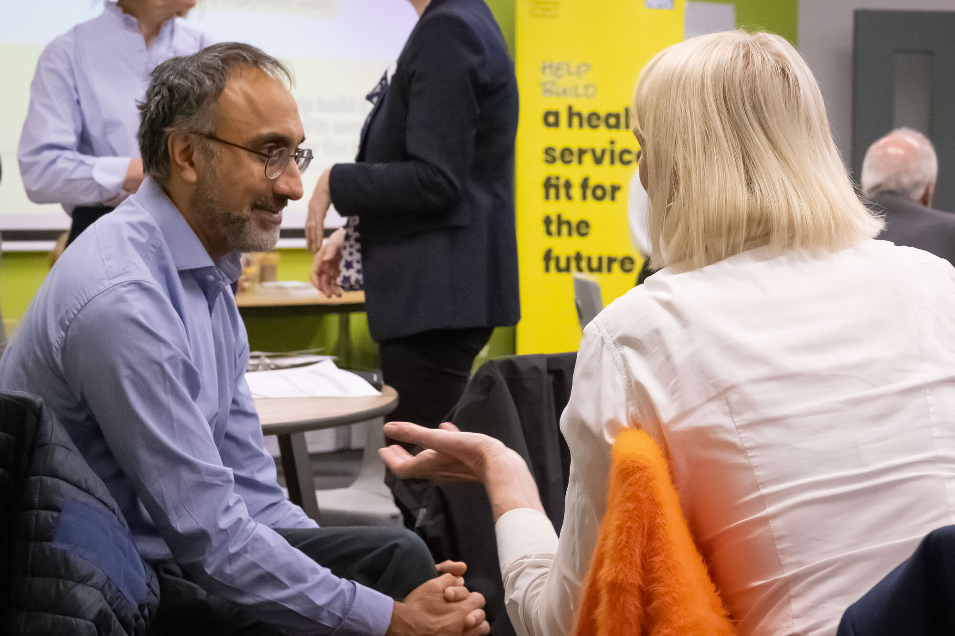
What have we learnt from the public through Change NHS?
The public and staff are fiercely proud of the health service, however they are frustrated that the system does not get the basics right.
The public’s vision for the NHS speaks to the three shifts with an expectation that the system will feel easier to access and more efficient once inside.
The public strongly emphasise prioritising foundational technology over more innovative examples.
There is support for increasing the delivery of healthcare within communities and for doing things differently, such as prioritising GPs time for those with complex needs.
The public support a greater focus on prevention, particularly an increase in education and interventions which prevent severe diseases (e.g. cancer).

Slide 6

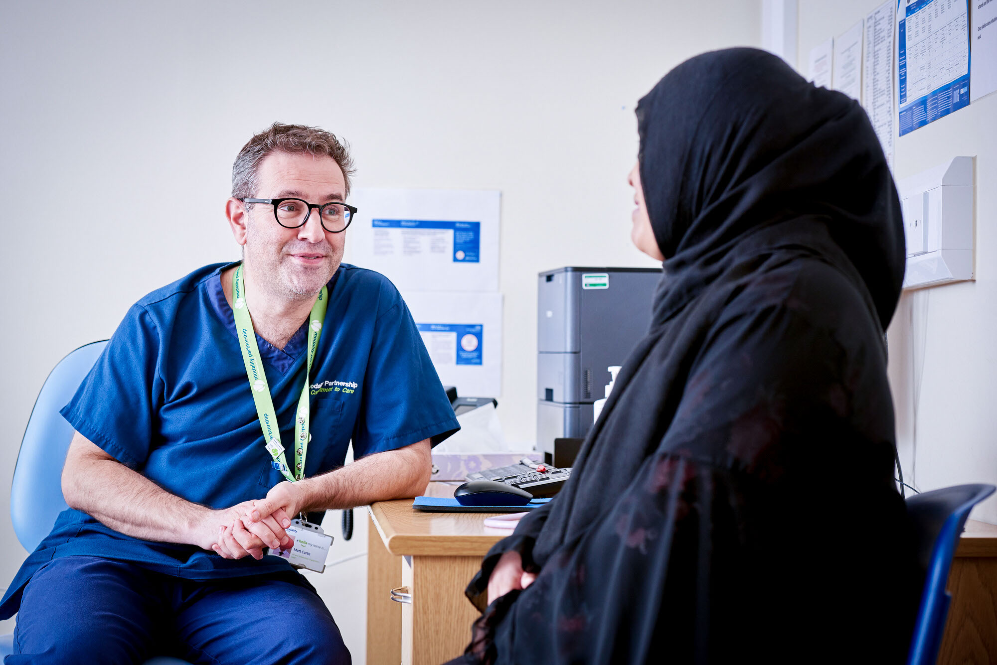
What have we learnt from health staff through Change NHS?
Staff are fiercely proud of delivering high-quality patient care and improving patient’s lives, however they face overlapping challenges.
The hospital to community shift would improve population health and quality of care but requires sustainable funding.
Technology must prioritise getting the basics right before investing in new tech innovations. Shared digital health records and consistent infrastructure are crucial.
Staff strongly support prevention, with clear emphasis on early intervention and education from a young age. Staff recognise that prevention aspects can sit outside of the NHS.
Staff shortages, technology infrastructure issues, and funding limitations all significantly impact workload.

Slide 7
The engagement exercise will run to Spring 2025
Oct | Nov | Dec | Jan | Feb | Mar | Apr | May
Private &
Online portal
Launch
Homepage update
Prioritisation exercise
Public Deliberation
7 regional events
Children & young people
Targeted focus groups
NATIONAL SUMMIT
Workforce Deliberation
15 online events
7 regional events
15 online events
SPRING: 10 YEAR PLAN
Community engagement
‘Workshop in a box’ events.
7
7
14 Feb - WIAB deadline
Partners
Partners’ council
Organisation portal responses
2 Dec deadline
Partners’ council
Partners’ council
System and local leaders
7 regional events
Local engagement

Slide 8
Policy approach
Vision – What do people want?
[vision and care model development]
Enabling – How do we get there and how do we make change happen?
[solution development]
Consolidation – Will these actions deliver the vision?
[check, challenge, consolidate]
Vision workstreams
1
2
3
4
I can stay healthy and manage my health in a way that works for me
I can access the high-quality and effective care I need, when and where I need it
My care is integrated around my needs, and I am listened to
I am treated in a fair and inclusive way, irrespective of who I am
Enabling workstreams
1
2
3
4
5
6
7
People
Finance and contracting
Physical infrastructure
Data and technology
Research, life sciences
and innovation
Accountability and oversight
Mobilising change

